Slide 1
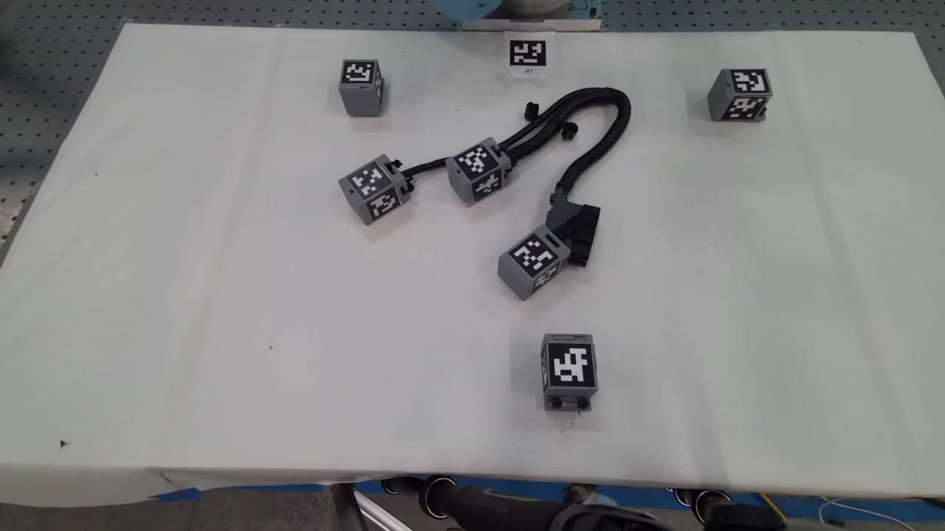
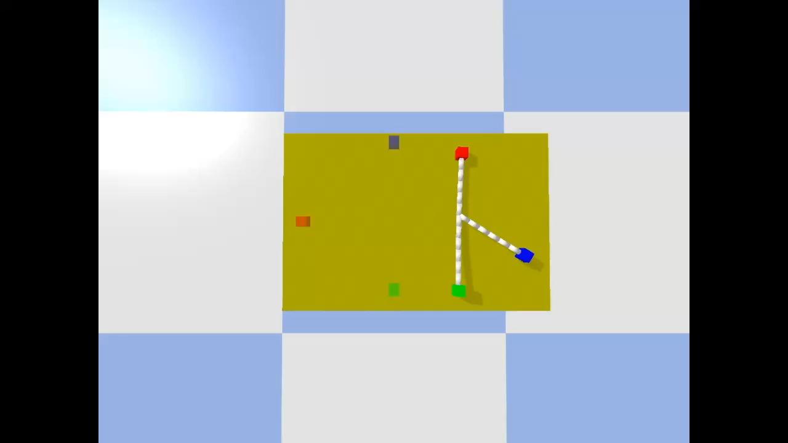
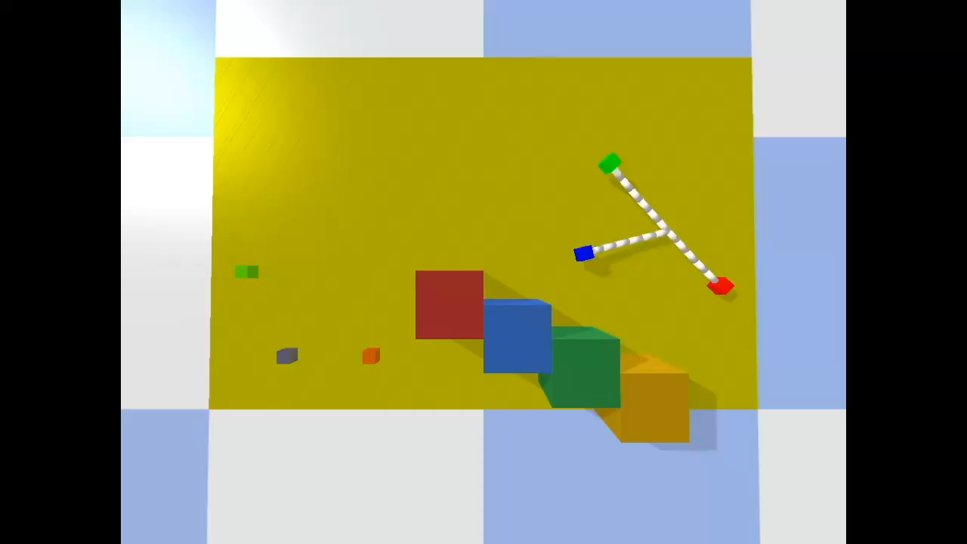
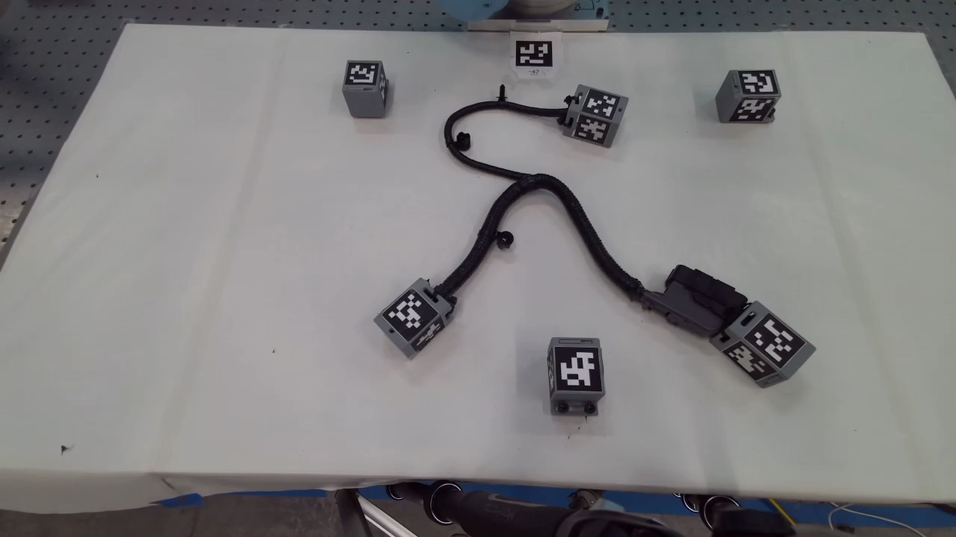

Sequential Manipulation of Deformable Linear Object Networks with Endpoint Pose Measurements using Adaptive Model Predictive Control
Tyler Toner^{1,3}, Vahidreza Molazedeh³, Miguel Saez³, Dawn M. Tilbury^{1,2}, Kira Barton^{1,2}
¹ Department of Mechanical Engineering, University of Michigan
² Robotics Department, University of Michigan
³ General Motors Research & Development

Slide 2
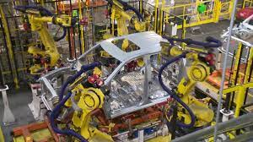
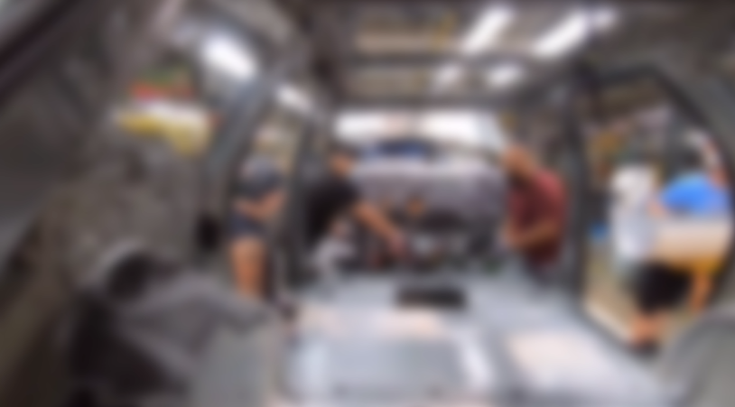
Unstructured task automation
Industrial robots today: structured, repetitive tasks
Wire harness installation remains a manual operation
Unstructured Tasks
Task sequence cannot be fully predicted due to uncertainty (e.g., cable flexibility)
Manually programmed:
Fixed PLC logic and robot trajectories.
Goal
Enable unstructured robotic manipulation tasks.

Slide 3
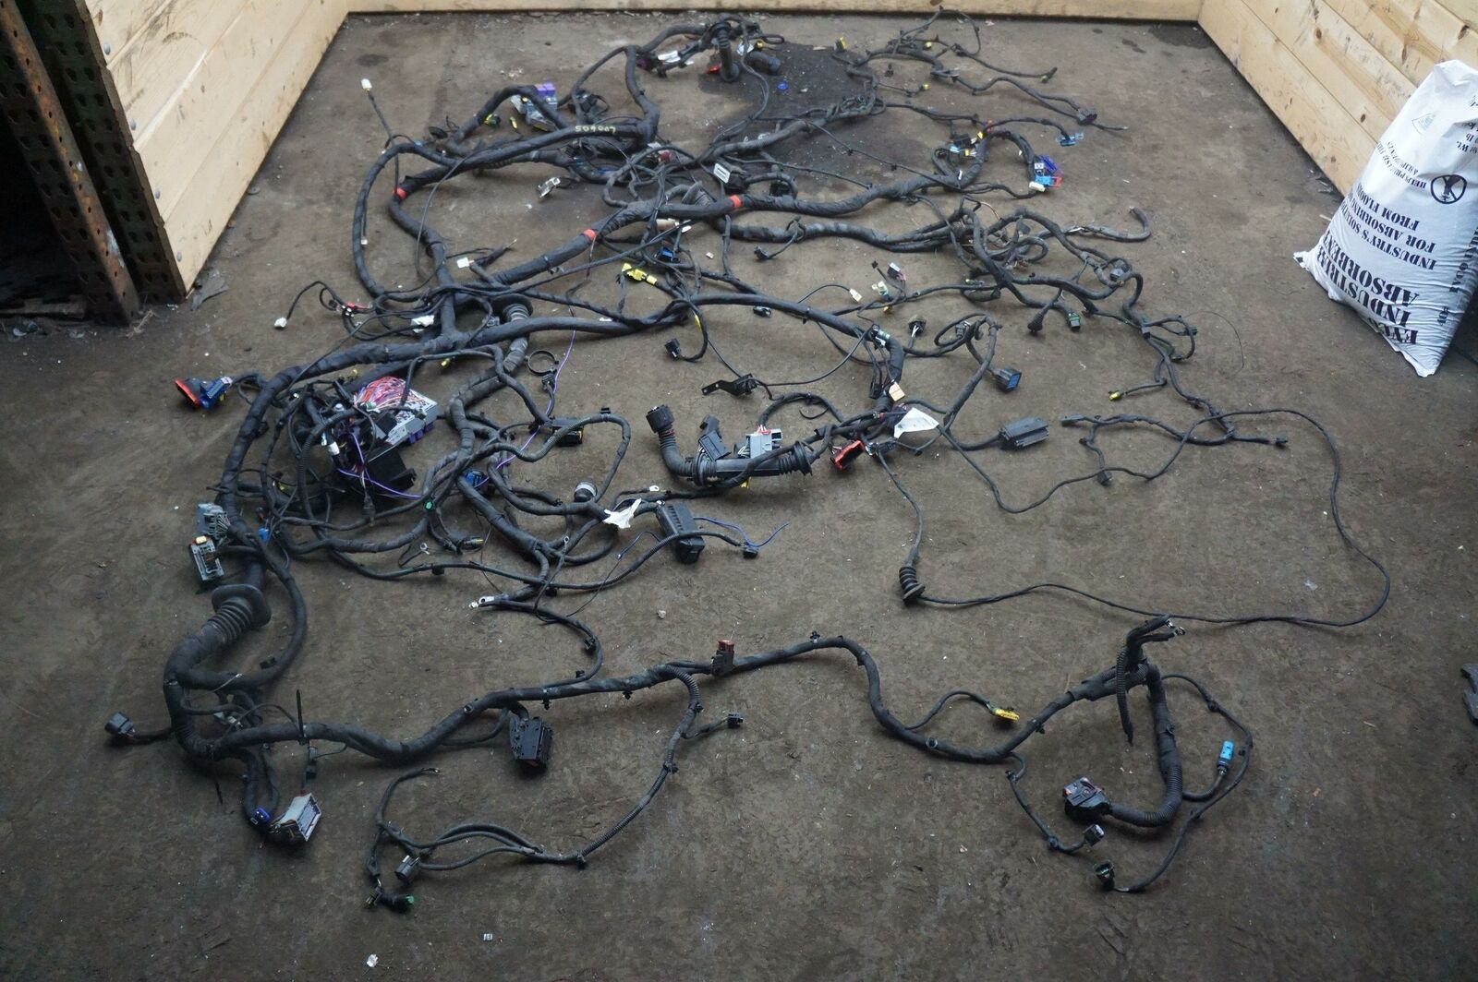
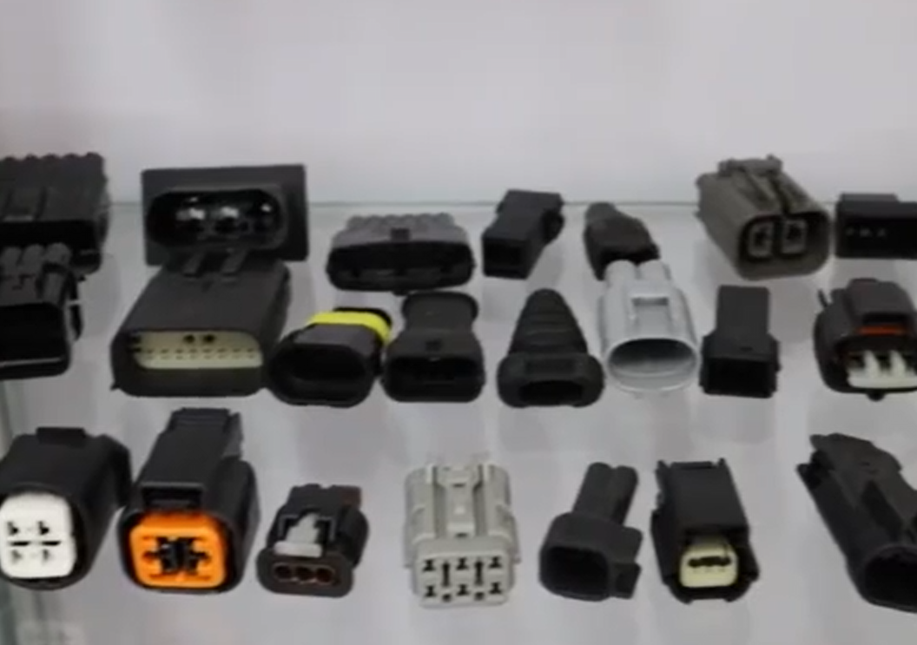
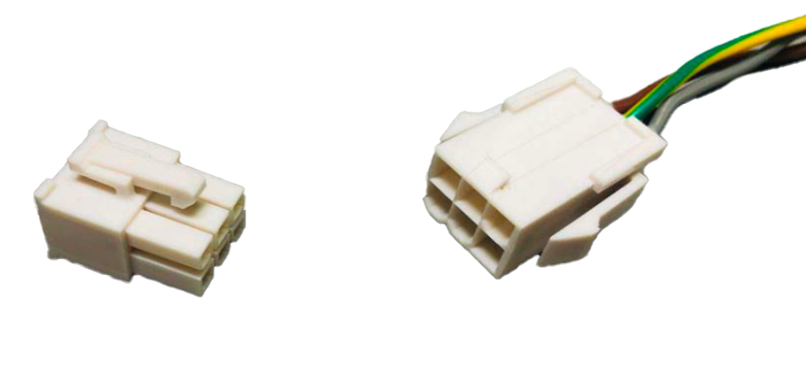
Wire harness installation
Main body wire harness, Ferrari 458 Italia
Wide variety of connector types
Manipulated terminals
Stationary receptacles
Figure: [Zhou et al. 2020]
Harness installation: Insert all terminals into their respective receptacles.

Slide 4
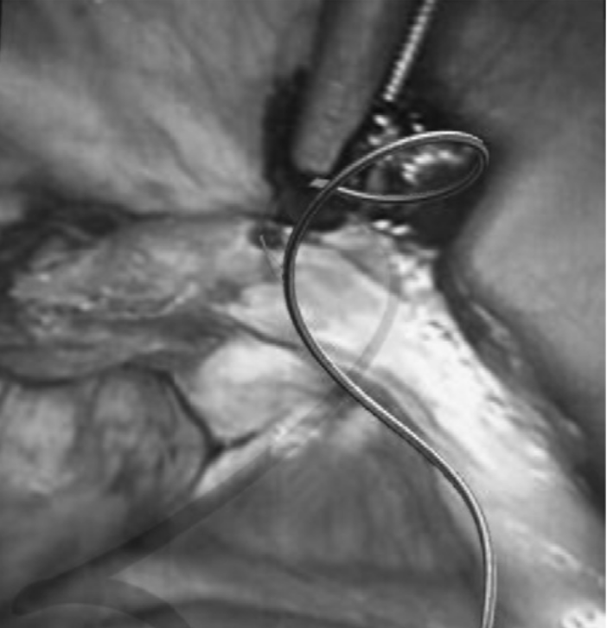
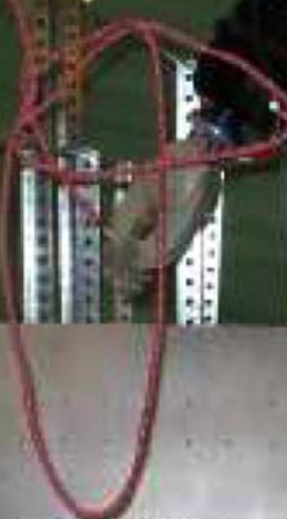
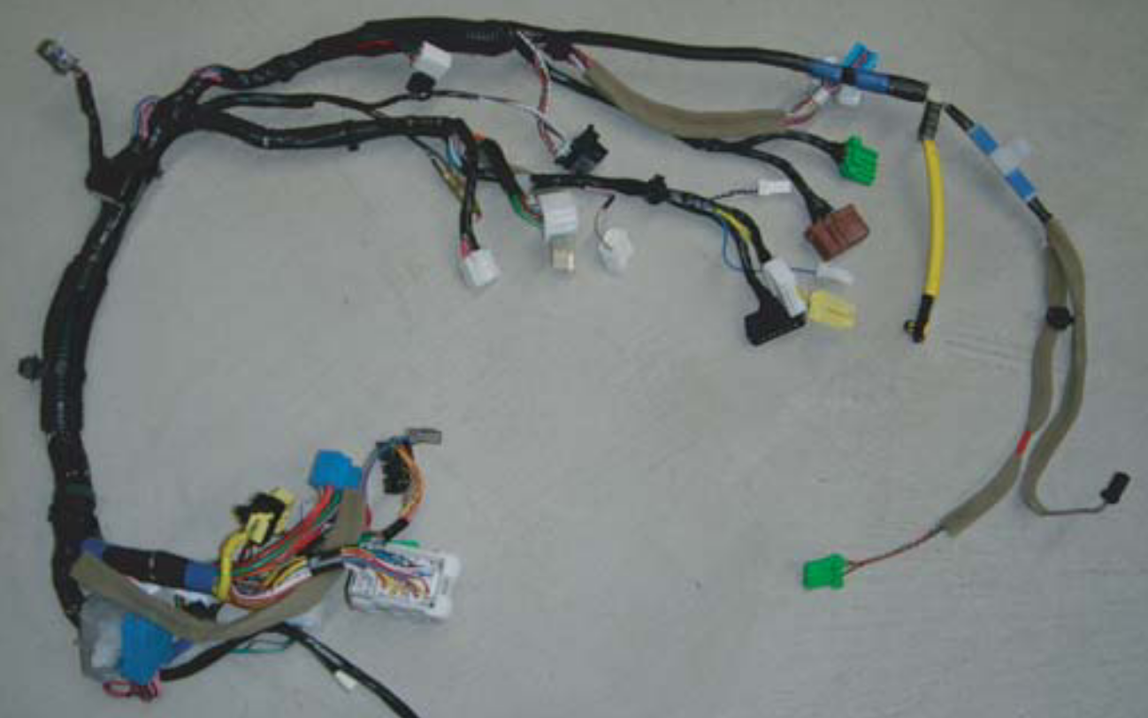
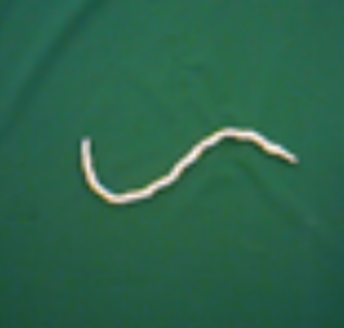
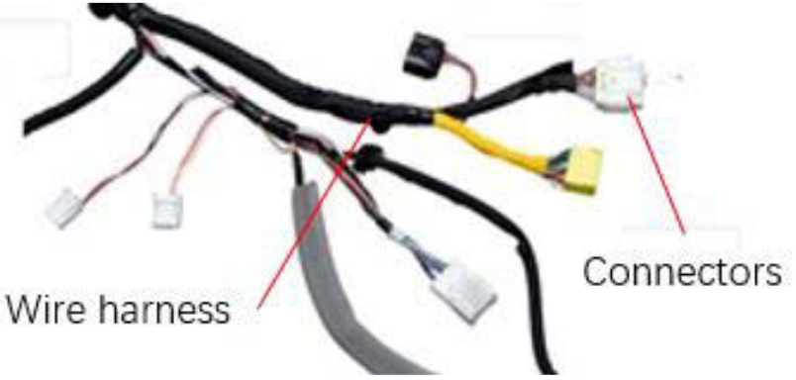
Deformable linear objects
[Moll et al. 2006]
[Saha et al. 2007]
[Yan et al. 2020]
[Jiang et al. 2010]
[Zhou et al. 2020]
Surgical sutures
Ropes
Strings
Wire harnesses
Deformable linear objects (DLOs)
DLO networks (DLONs)

Slide 5
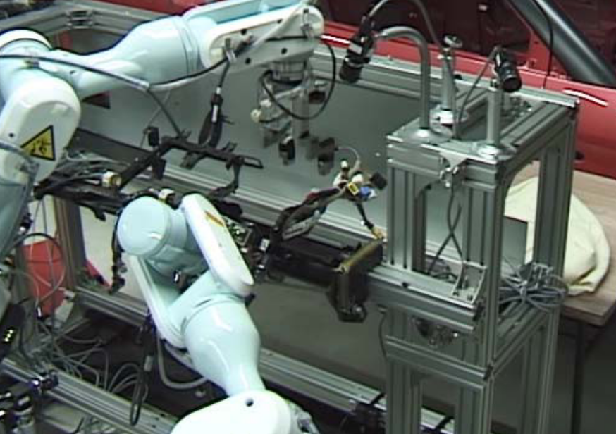
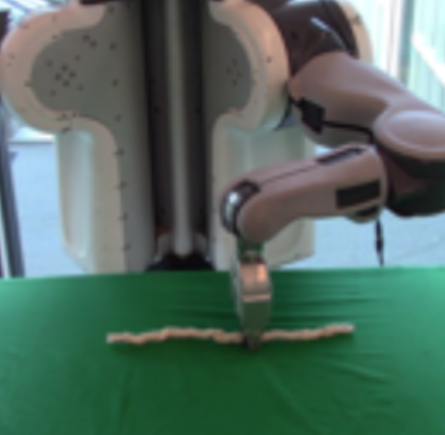
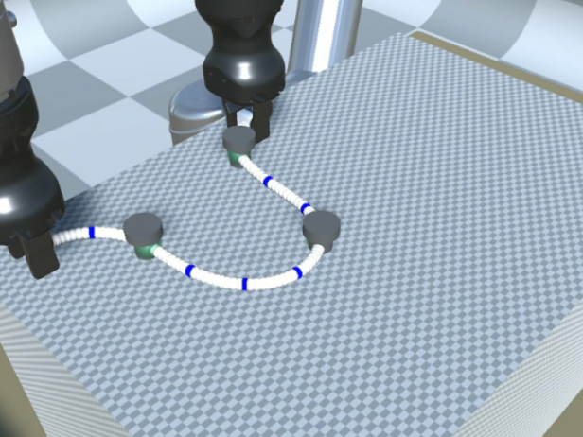
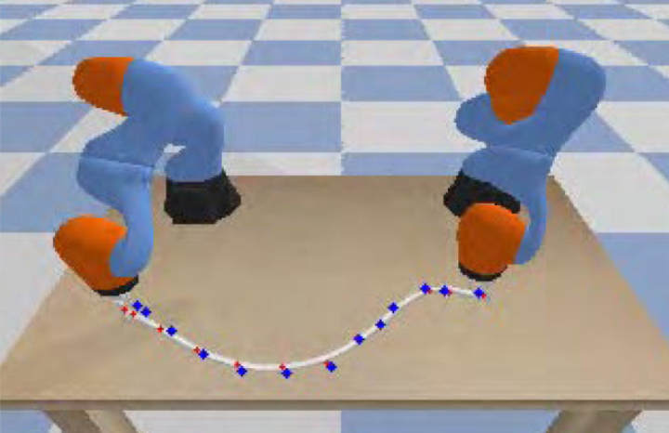
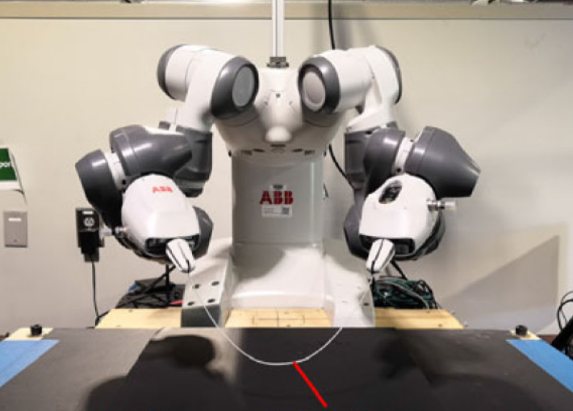
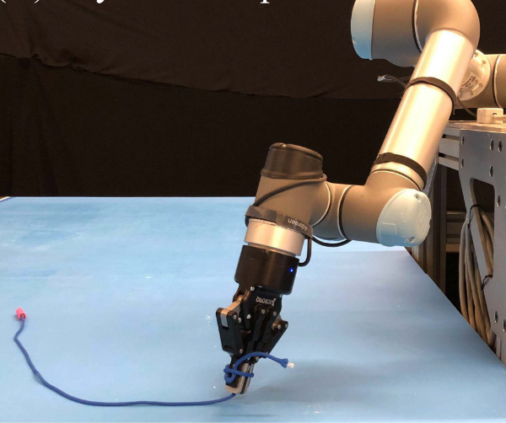
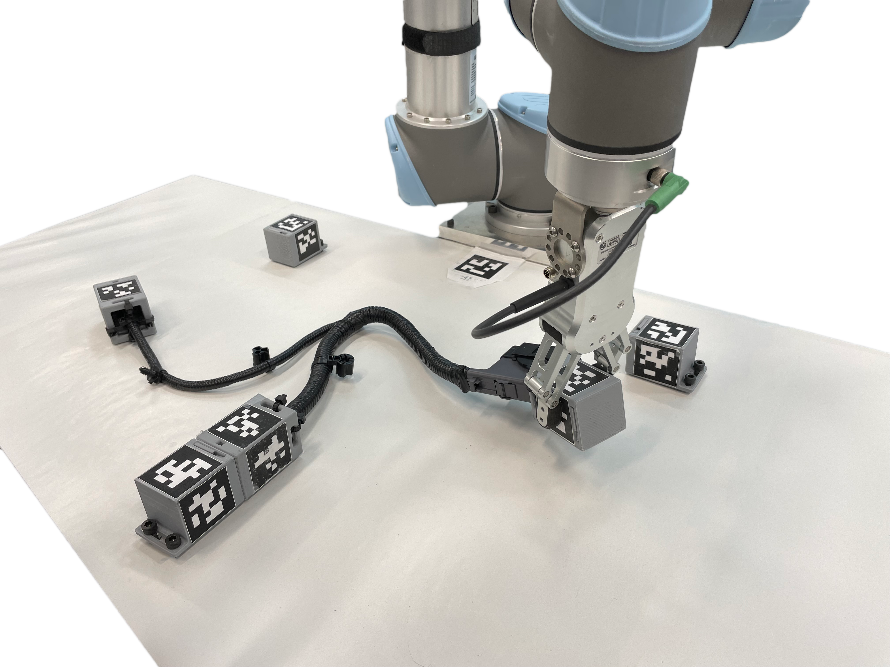
Most DLO research focuses on dual arm manipulation with shape perception for shape goals
But practical harness installation scenarios involve confined environments
limited visibility, and are specified by
endpoint goals
 | No. manipulators | Measurement | Goal | DLO networks
Multi-arm, marker-based harness installation [Jiang et al. 2010] | ≥ 2 | keypoints | keypoints | yes
Vision-based DLO shape control w/ learned predictive model [Yan et al. 2020] | 1 | shape | shape | no
Dual-arm shape control w/ adaptive model [Yu et al. 2021] | 2 | shape | keypoints | no
Dual-arm shape control with learned graph network model [Wang et al. 2022] | 2 | shape | shape | no
Dual-arm shape control with explicit DLO model [Lv et al. 2022] | 2 | shape | shape | no
DLO endpoint casting w/ endpoint measurements [Lim et al. 2022] | 1 | endpoint | endpoint | no
DLON endpoint feedback control w/ endpoint measurements [Ours] | 1 | endpoints | endpoints | yes
Notes:
The majority of DLO manipulation research focuses on dual arm manipulation with perception of the full DLO shape, or state.
In practical scenarios, like automotive wire harness installation, confined environments and limited visibility complicate these assumptions.
Confined environments are better suited to single manipulators
And limited visibility may lead to spatially sparse measurements.

Slide 6
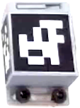
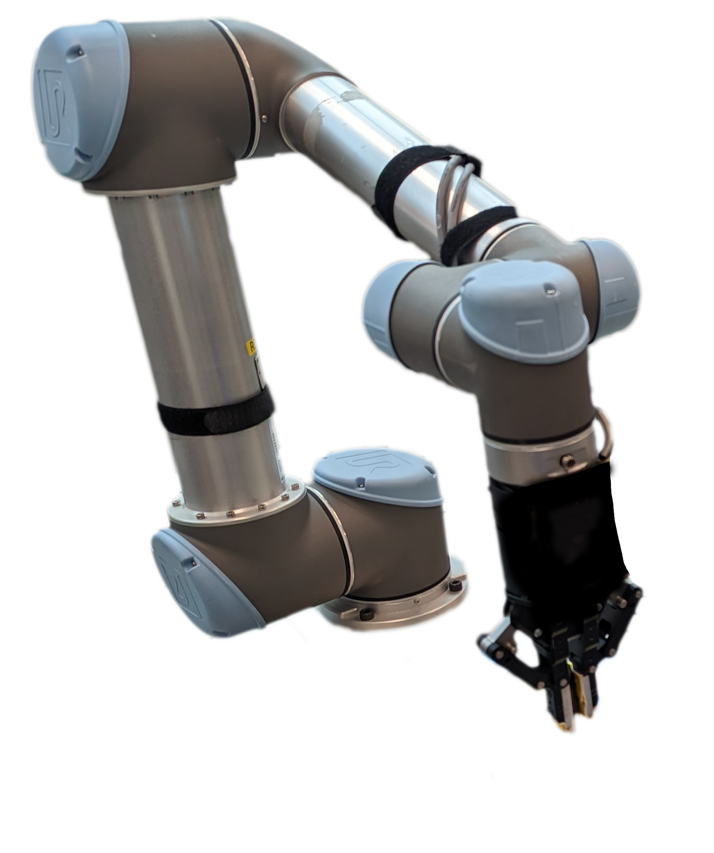
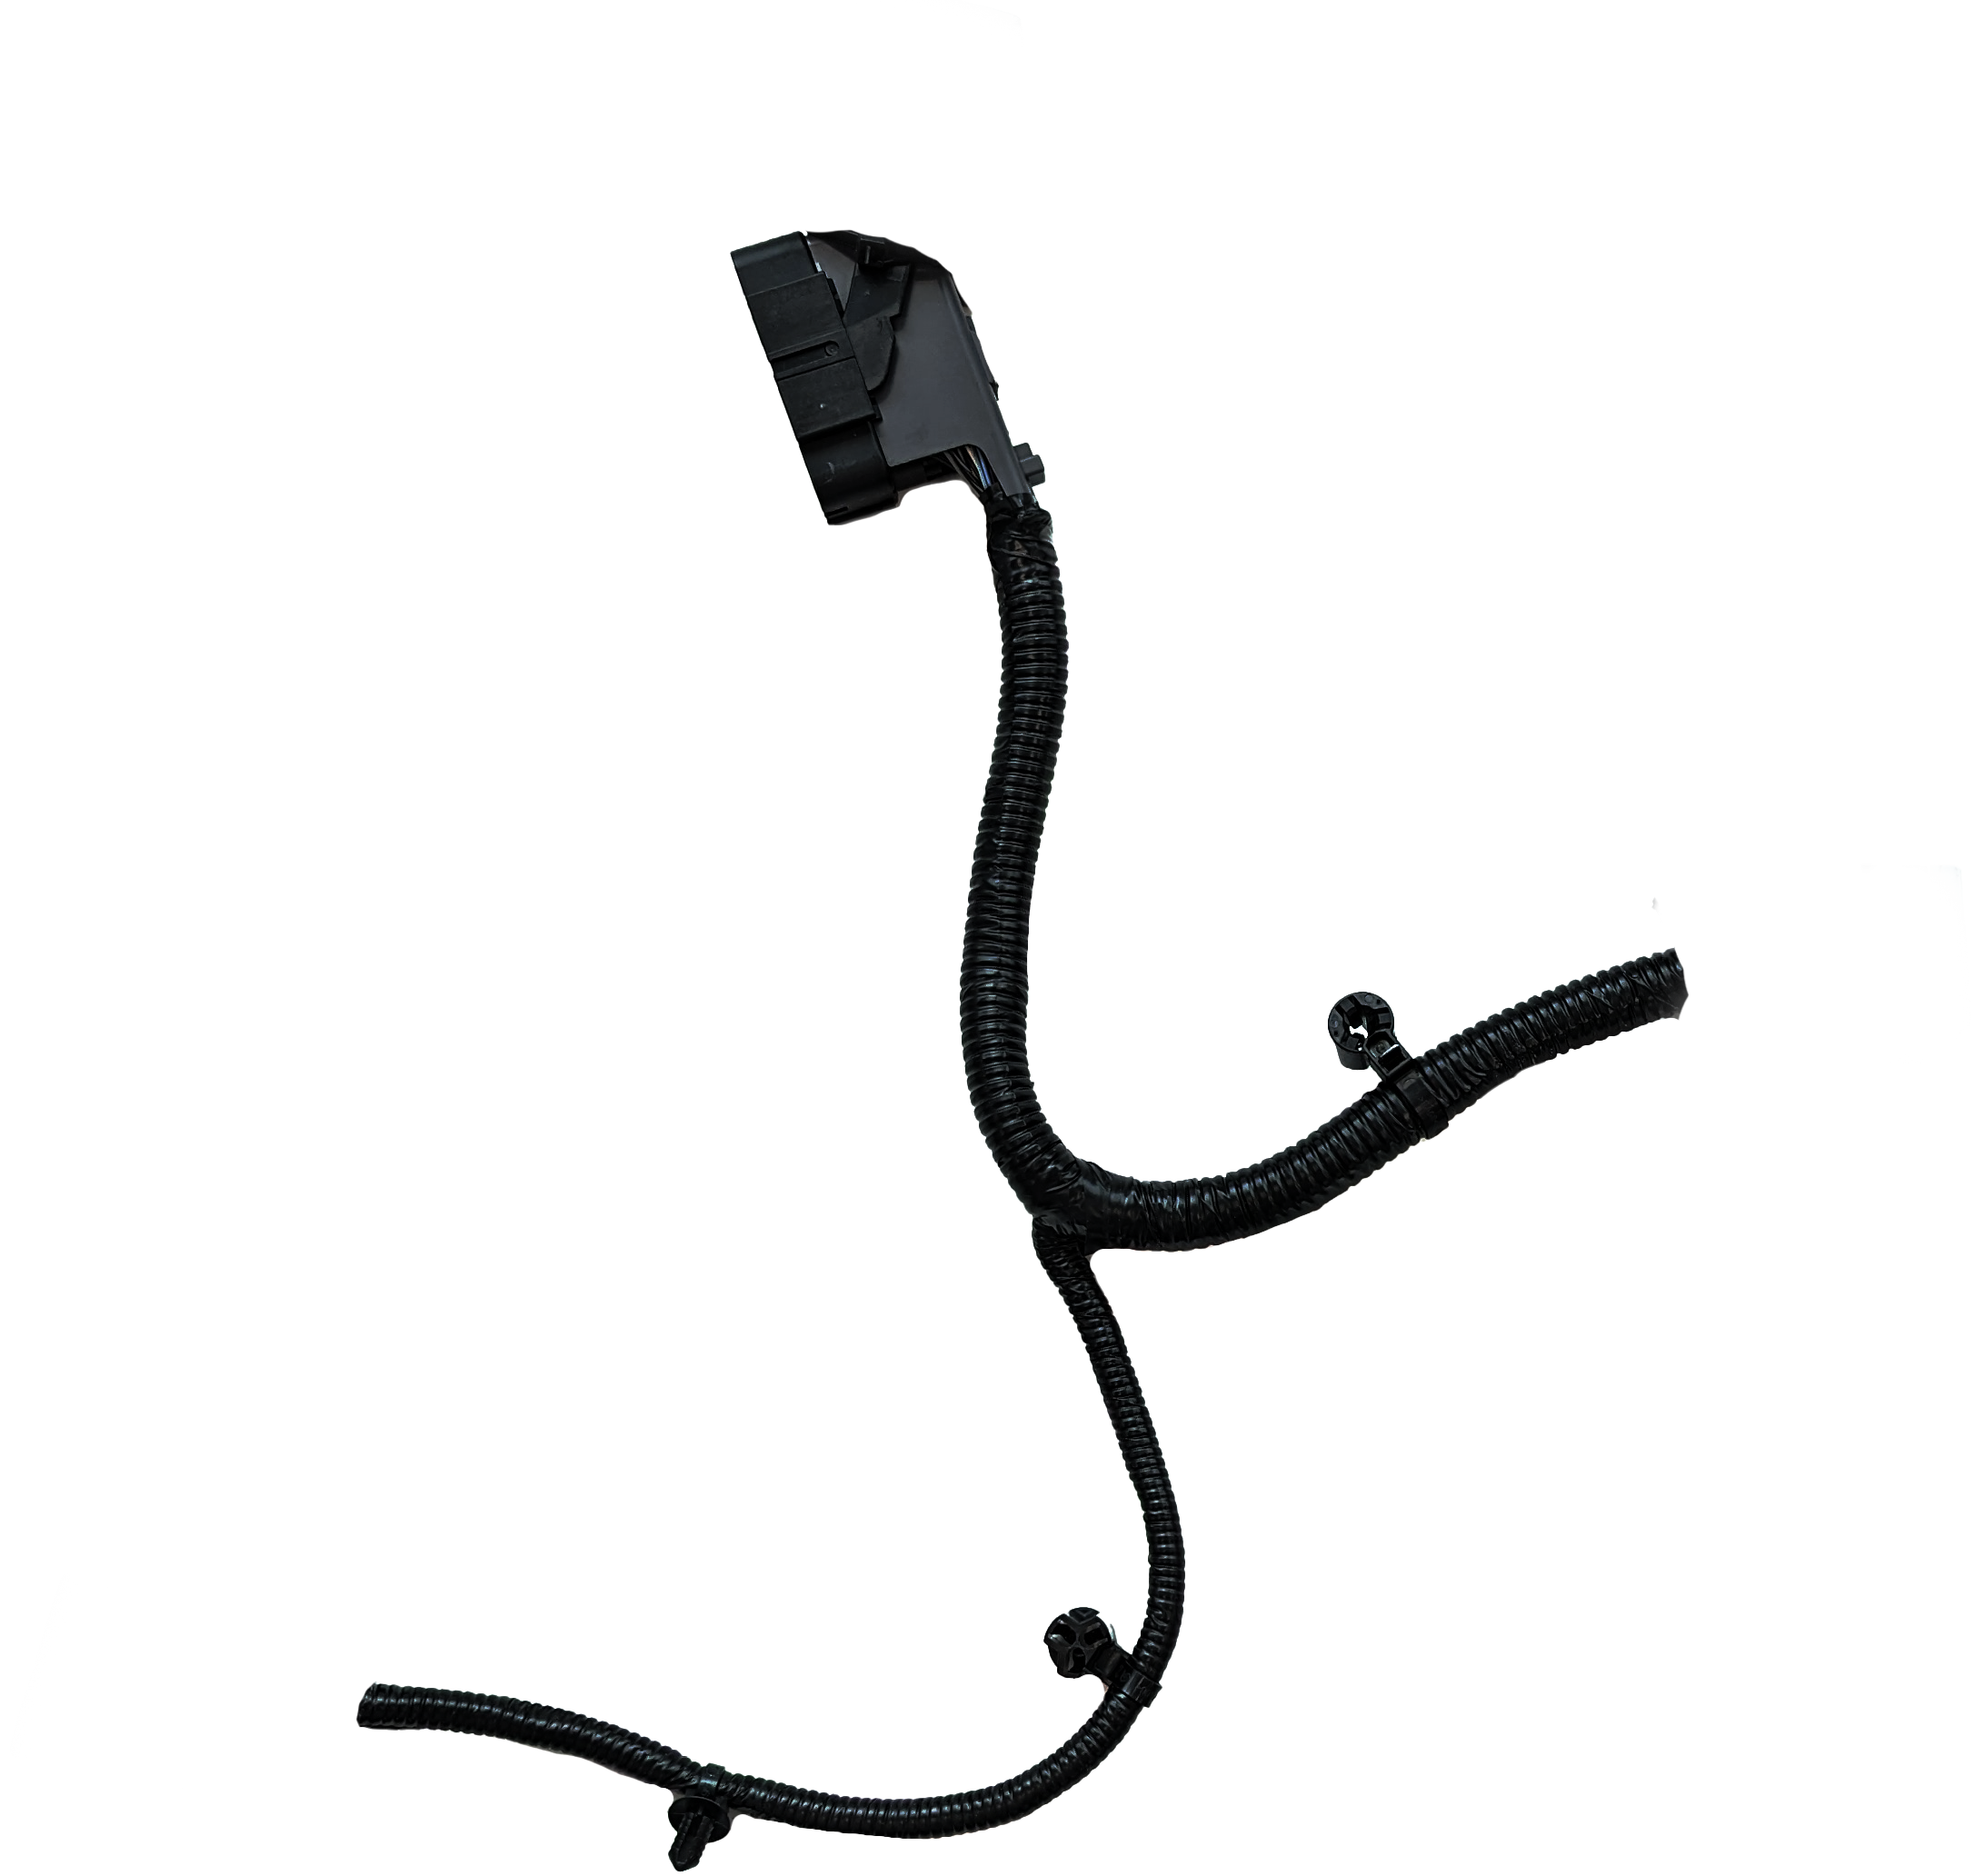
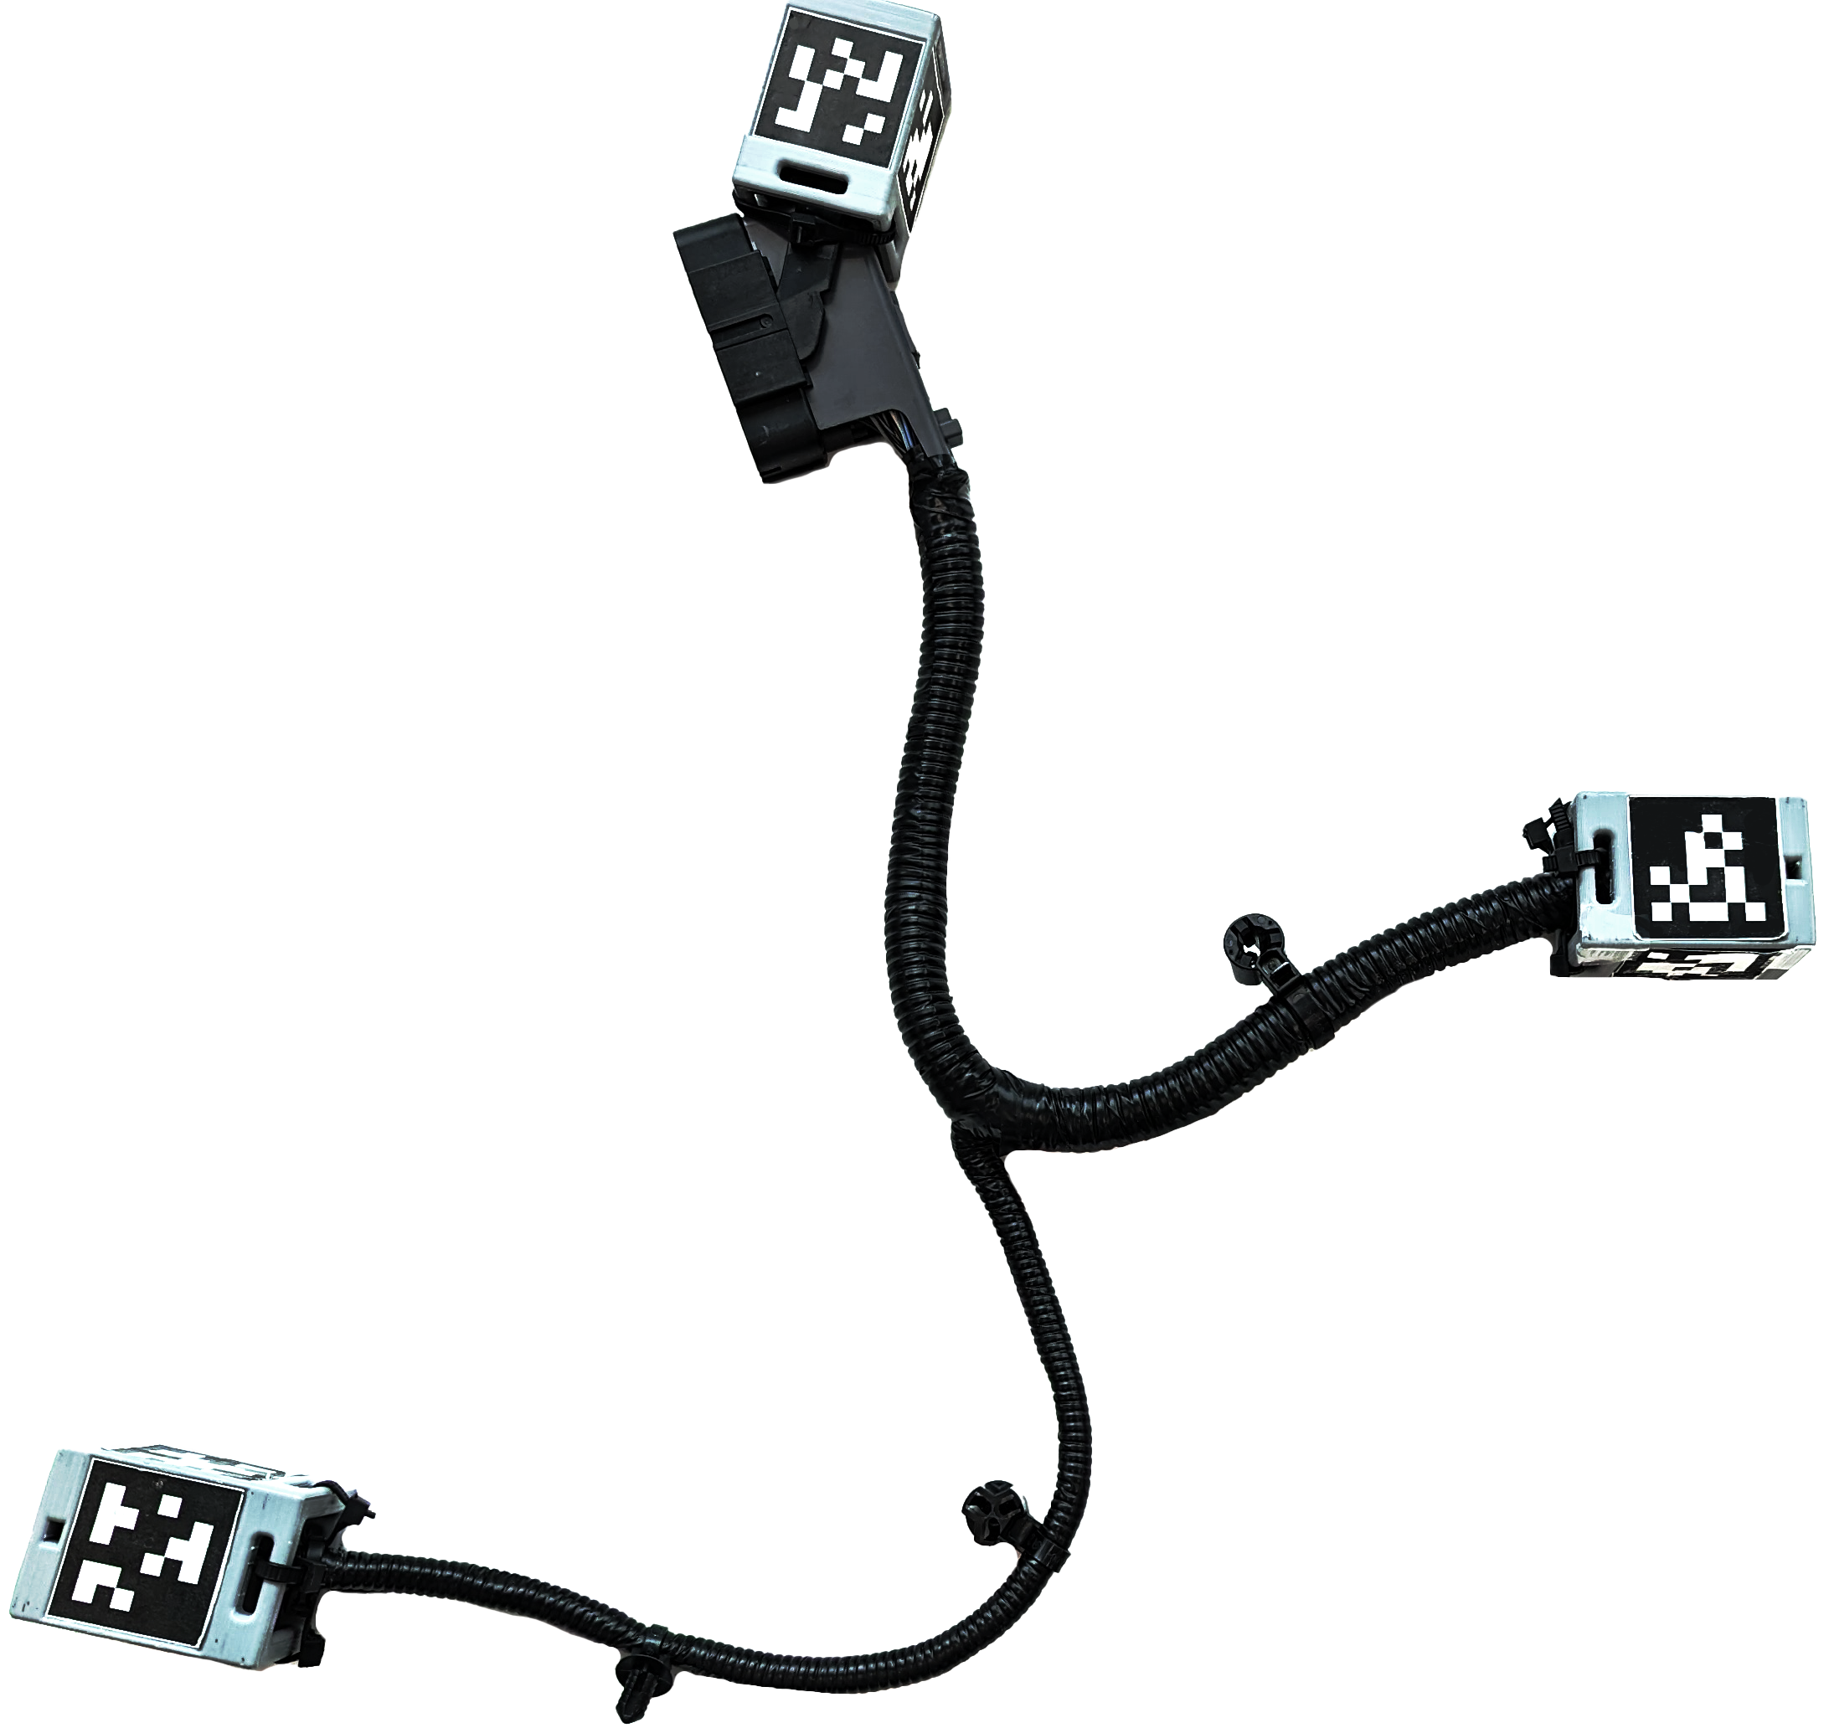
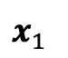
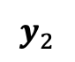
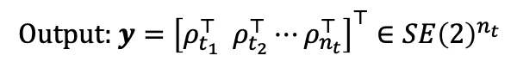
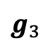
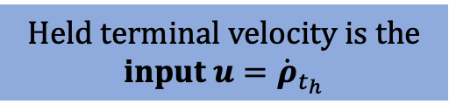
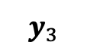
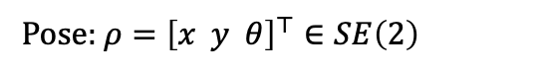
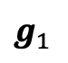
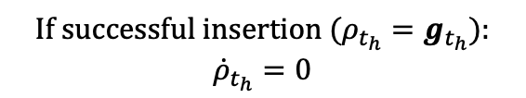
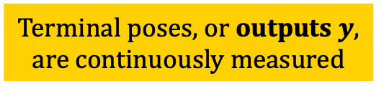

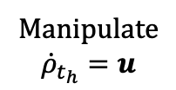
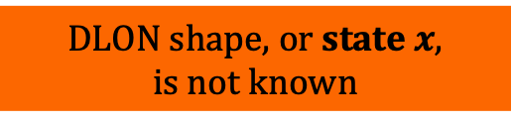
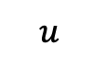
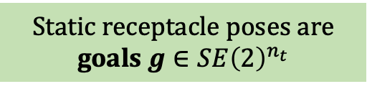
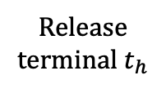
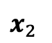
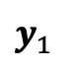
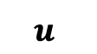
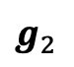
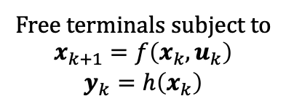
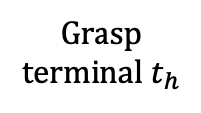
$$g_{2}$$
DLON shape, or state $x$, is not known
$y_{3}$
$$g_{3}$$
$$u$$
Terminal poses, or outputs $y$, are continuously measured
Pose: $ρ={\left[x y θ\right]}^{⊤}∈SE\left(2\right)$
$y_{2}$
Output: $y={\left[ρ_{t_{1}}^{⊤} ρ_{t_{2}}^{⊤}⋯ρ_{n_{t}}^{⊤}\right]}^{⊤}∈SE{\left(2\right)}^{n_{t}}$
$y_{1}$
Static receptacle poses are goals $g∈SE{\left(2\right)}^{n_{t}}$
$$g_{1}$$
$$x_{1}$$
$$x_{2}$$
$$⋯$$
$$u$$
Held terminal velocity is the input $u={\dot{ρ}}_{t_{h}}$
We investigate single-arm installation
of planar DLO networks
with terminal pose measurements and goals
Installation requires sequence of terminal manipulations (TMs):
Grasp terminal $t_{h}$
Manipulate
$${\dot{ρ}}_{t_{h}}=u$$
Free terminals subject to
$$x_{k+1}=f\left(x_{k}, u_{k}\right)$$
$$y_{k}=h\left(x_{k}\right)$$
Release terminal $t_{h}$
If successful insertion ($ρ_{t_{h}}=g_{t_{h}})$:
$${\dot{ρ}}_{t_{h}}=0$$

Slide 7
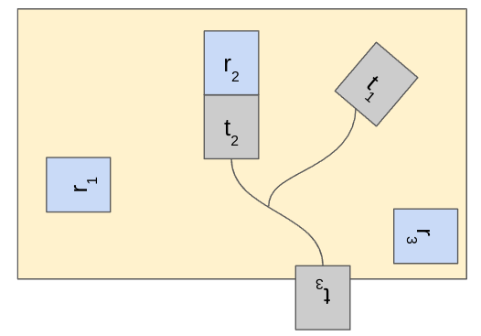
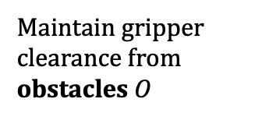
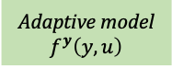
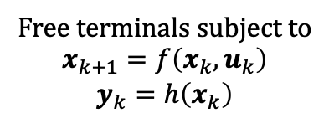












Installation requires sequence of terminal manipulations (TMs):
Grasp terminal $t_{h}$
Manipulate
$${\dot{ρ}}_{t_{h}}=u$$
Free terminals subject to
$$x_{k+1}=f\left(x_{k}, u_{k}\right)$$
$$y_{k}=h\left(x_{k}\right)$$
Release terminal $t_{h}$
If successful insertion ($ρ_{t_{h}}=g_{t_{h}})$:
$${\dot{ρ}}_{t_{h}}=0$$
Remain within reachable workspace $W$
$f, h$ unknown and time-varying
free terminals should remain graspable
$$t_{i}$$
$$d_{ij}>ε_{r}$$
Maintain gripper clearance from obstacles $O$
$$r_{j}$$
TM Sequence Planner
Grasp terminal
TM Controller
Terminal manipulation
DLON
Terminal pose goals $g$ $$\text{Obstacles} O$$
Adaptive model $f^{y}\left(y,u\right)$
Constrained MPC
$$u$$
$$y$$
Vision system

Slide 8








Do direct input-output dynamics exist? $f^{y}$ : $y_{k}, u_{k}, x_{k}→y_{k+1}$
What is the structure of $f^{y}$?
Can $f^{y}$ be approximated online?
$$x_{k+1}=f\left(x_{k}, u_{k}\right)$$
$$y_{k}=h\left(x_{k}\right)$$
Adaptive model $f^{y}\left(y,u\right)$
Empirical observation: Given fixed terminal poses $\overline{y}$, the DLON returns to a stable shape $x→\overline{x}$
Hypothesis: the output map $h$ is approximately invertible:
$∃ H:SE{\left(2\right)}^{n_{t}}→ℬ\left(x, ε_{x}\right)$ such that $\left\|h\left(H\left(y\right)\right)−y\right\|<ε_{y}$
If so, then:
reconstruction error
$$y_{k+1}=h\left(x_{k+1}\right)$$
$$=h\left(f\left(x_{k}, u_{k}\right)\right)$$
$$≈h\left(f\left(H(y_{k}), u_{k}\right)\right)$$
$$=f^{y}\left(y_{k}, u_{k}\right)$$
✓
Notes:
Methodology:
Excite simulated DLON and collect dataset
Fit models and draw insights
Develop general DLON model

Slide 9
















Simulated DLON
Random excitations $u$
Dataset $𝒟=\left\{{\left(y, x, u, x^{′}, y′\right)}_{i}\right\}$
$$⋯$$
Neural network approximations of $\hat{h}, \hat{H}$
Supervised learning
NN approximation of $f^{y}\left(y, u\right)$
Approximate inversion hypothesis supported
Training error indicates good fit
$\hat{h}\left(\hat{H}(y)\right)$ reconstructs $y$
How can $f^{y}$ be approximated in an interpretable way?
Notes:
Methodology:
Excite simulated DLON and collect dataset
Fit models and draw insights
Develop general DLON model

Slide 10



Sparse Identification of Nonlinear Dynamics (SINDy)
[Brunton et al. 2016]
Objective: Learn $f^{y}\left(y, u\right)$ from dataset $𝒟=\left\{{\left(y, u, y′\right)}_{i}\right\}$ using a library of nonlinear terms:
$$Θ\left(y, u\right)=\left[1 y y^{2} ⋯ u u^{2}⋯ yu ⋯\sin\left(y\right)⋯\right]$$
Then solve for sparse coefficients $Ξ$ using regularization $R\left(Ξ\right)$
$$\min_{Ξ} \sum_{𝒟}{‖ \dot{y}−Θ\left(y, u\right)}Ξ{\left.​\right\|}_{2}^{2}+R\left(Ξ\right)$$
Polynomial model $f_{s}^{y}$ predicts dynamics, though rougher than NN model $f_{nn}^{y}$

Slide 11




Polynomial model admits useful decomposition
We find significant rigid body dynamics $f_{rb}^{y}$ in $f_{s}^{y}$
$$Θ\left(y, u\right)=Cf_{rb}^{y}\left(y, u\right)+f_{res}^{y}\left(y, u\right)$$
Where, for free terminal $t$ subject to held terminal velocities $u={\dot{ρ}}_{h}$:
$$f_{rb}^{ρ_{t}}\left(ρ_{t}, u\right)=\left[\begin{matrix}1 & 0 & y_{h}−y_{t} \\ 0 & 1 & x_{t}−x_{h} \\ 0 & 0 & 1\end{matrix} \right]u$$
RB dynamics explanation frequency over all samples in $𝒟$

Slide 12




Adaptive ensemble model
Local linear model:
$$\dot{y}=B_{ls}u$$
where $B_{ls}$ is approximated over the last $N_{e}$ samples:
$$B_{ls}^{∗}←\arg{\min_{B_{ls}}{\sum_{j=1 }^{N_{e}}{{\left\|{\dot{y}}_{k−j}−B_{ls}u_{k−j}\right\|}^{2}}}}$$
Learns subtle relationships between free terminals
Estimation involves delay and control excitation
Global rigid body model:
$$\dot{y}=B_{rb}u$$
where $B_{rb}$ is known and fixed
Can be deployed immediately without delay
Captures only bulk dynamics
Ensemble model that captures benefits of both:
$${\hat{B}}_{k}=α_{k}B_{rb}+\left(1−α_{k}\right)B_{ls}$$
where $α_{k}∈\left[0, 1\right]$ is trust in rigid body model and decays over time at rate $γ∈\left(0, 1\right):$
$α_{0}=1$
$α_{k+1}=γα_{k}$
Maximum prediction errors over 5 seconds using last 1 second of data:

Slide 13



Terminal manipulation controller and sequence planner
Planner heuristically chooses the next terminal to hold based on current constraint proximity:
Controller drives held terminal to goal without driving free terminals into constraint violation:

Slide 14

Simulation experiments
Applied framework with rigid body model and ensemble model to increasingly challenging problems

Slide 15

The framework performs well on simple problems with either the ensemble model or rigid body model alone.
Ensemble model
(a) easy
(b) rotated
Playback speed: 4x
Notes:
Our framework performs well on simple problems with either the ensemble model or rigid body model alone. Here, each terminal is to be connected to a receptacle of the same color.

Slide 16


When navigating through a narrow opening, the framework with the ensemble model succeeds, while that with the rigid body model becomes stuck.
(c) obstacle
Rigid body model
Ensemble model
Does not finish
Playback speed: 4x
Notes:
For more complex problems, like navigating through a narrow opening, the framework using the ensemble model succeeds while the rigid body model fails, indicating that the local regression model learns important components of the dynamics

Slide 17

When navigating around a wall of obstacles, the framework with both models succeed, but that with the ensemble model avoids obstacles more reliably.
(d) hall
Rigid body model
Ensemble model
Playback speed: 8x
Notes:
In other challenging problems, both models succeed, but the framework with the ensemble model avoids obstacles more reliably.

Slide 18

Static receptacles
Physical case study: automotive wire harness installation
Magnetic mating to simulate insertion
Modified automotive wire harness
(b) basic
(c) bunched
(d) tough
Framework with ensemble model solves problem with a variety of initial conditions without a priori learning or system identification.
Playback speed: 10x
Notes:
To evaluate the generality of the framework, we consider a physical case study of automotive wire harness installation
A modified wire harness with 3 terminals [ ] is to be mated to to three static receptacles.
The framework with the ensemble model solves installation problems with a variety of initial conditions without a priori knowledge of dynamics or system identification

Slide 19

t₂
t₁
initially ungraspable due to obstacle proximity
t₂
t₀
planner chooses to hold T1 and use it to pull T2 out of constraint violation
t₁
t₂
Sequence planner reasons about present grasp feasibility.
Notes:
The sequence planner reasons about the present grasp feasibility.
In this case, T2 is initially ungraspable due to obstacle proximity.
So the planner chooses to hold T1 and use it to pull T2 out of constraint violation

Slide 20




$$v_{2}$$
Once held, the MPC selects $u$ using the ensemble model to predict $v_{2}$
$$u=v_{1}$$
Sequence planner reasons about present grasp feasibility.
Controller preserves future grasp feasibility.
Notes:
The controller preserves future grasp feasibility.
Once held, the MPC selects u using the ensemble model to predict the velocity of T2

Slide 21
Sequence planner reasons about present grasp feasibility.
Controller preserves future grasp feasibility.
Notes:
to ensure it does not enter an infeasible region during manipulation.

Slide 22


Conclusions
Planar DLON output maps are approximately invertible:
$∃ H:SE{\left(2\right)}^{n_{t}}→ℬ\left(x, ε_{x}\right)$ such that $\left\|h\left(H\left(y\right)\right)−y\right\|<ε_{y}$
Direct output dynamics exist
$f^{y}$ : $y_{k}, u_{k}, x_{k}→y_{k+1}$
and can be decomposed into rigid body and residual terms, leading to an adaptive ensemble model that generalizes to new DLONs:
$${\hat{B}}_{k}=α_{k}B_{rb}+\left(1−α_{k}\right)B_{ls}$$
Based on the above, our planning and control framework can solve a variety of DLON installation problems without offline training or online excitation.

Slide 23



Future work
Validation on more complex DLONs
Leverage output map invertibility to predict state and satisfy state constraints
Utilize data collected from iterative installations to build global model and enable more intelligent planning.
[Wang et al. 2022]

Slide 24










Terminal sequence planner
Grasp terminal
Held terminal controller
Move held terminal
DLON
Terminal pose goals $g$
Adaptive model
Constrained MPC
$$u$$
$$y$$
Input-output model without state dependence:
Vision system
$$y_{k+1}=f^{y}\left(y_{k}, u_{k}\right)$$
$$≈$$
$${\hat{f}}_{ }^{y}\left(y_{k}, u_{k}\right)$$
$$=$$
$$f_{rb}^{y}\left(y_{k}, u_{k}\right)$$
$$+$$
$$f_{ls}^{y}\left(y_{k}, u_{k}\right)$$
Composite model
Rigid body model
Local regression model
Notes:
In this work, we investigate single-arm manipulation [ ] of planar DLO networks [ ] with terminals pose measurements
This means that the overall shape of the DLON, or its state, is not known
Instead, the terminal poses, or outputs, are continuously measured
The manipulator holds a single terminal at a time and the commanded velocity of the held terminal is the input to the system
The goal poses of all terminals are given, and a planner selects which terminal to grasp next.
The held terminal controller generates velocity command inputs to the DLON system
A vision system provides continuous terminal pose measurements to the controller and planner.
The held terminal controller consists of a model predictive controller with task-relevant constraints, [ ] which uses an adaptive model learned online
The adaptive model predicts output dynamics without knowledge of the state or state dynamics
We approximate output dynamics with an composite model, [ ] which is composed of a general rigid body model, which enables control without prior learning, and a local regression model that gradually incorporates learned dynamics.

Slide 25
$$g_{2}$$
DLON shape, or state $x$, is not known
$y_{3}$
$$g_{3}$$
$$u$$
Terminal poses, or outputs $y$, are continuously measured
Pose: $ρ={\left[x y θ\right]}^{⊤}∈SE\left(2\right)$
$y_{2}$
Output: $y={\left[ρ_{t_{1}}^{⊤} ρ_{t_{2}}^{⊤}⋯ρ_{n_{t}}^{⊤}\right]}^{⊤}∈SE{\left(2\right)}^{n_{t}}$
$y_{1}$
Static receptacle poses are goals $g∈SE{\left(2\right)}^{n_{t}}$
$$g_{1}$$
$$x_{1}$$
$$x_{2}$$
$$⋯$$
$$u$$
Held terminal velocity is the input $u={\dot{ρ}}_{t_{h}}$
We investigate single-arm installation
of planar DLO networks
with terminal pose measurements and goals
Installation requires sequence of terminal manipulations (TMs):
Grasp terminal $t_{h}$
Manipulate
$${\dot{ρ}}_{t_{h}}=u$$
Free terminals subject to
$$x_{k+1}=f\left(x_{k}, u_{k}\right)$$
$$y_{k}=h\left(x_{k}\right)$$
Release terminal $t_{h}$
If successful insertion ($ρ_{t_{h}}=g_{t_{h}})$:
$${\dot{ρ}}_{t_{h}}=0$$

